Slide 1

MySecret.Studio
By
Jason Engelbrecht
Sathvika Tarimela

Slide 2






How does it work?
CDN
Log cleaning
Process
Google Data Storage
Web Front End
Message Queue
Rate Limiter
3rd Party SMS Gateway
SMS Processor

Slide 3
Behind the scenes
Out of band communications
Optimized website to work on mobiles as well as desktop
Functionality like delete and delete all
Database encryption using mobile number as Salt
Using CRON jobs/background times scripts to clean up the database
Rate limiter – 40 passwords per Mobile number
Integration with 3rd party API to send SMS
Using push message queues to send SMS

Slide 4




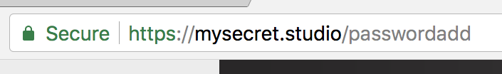
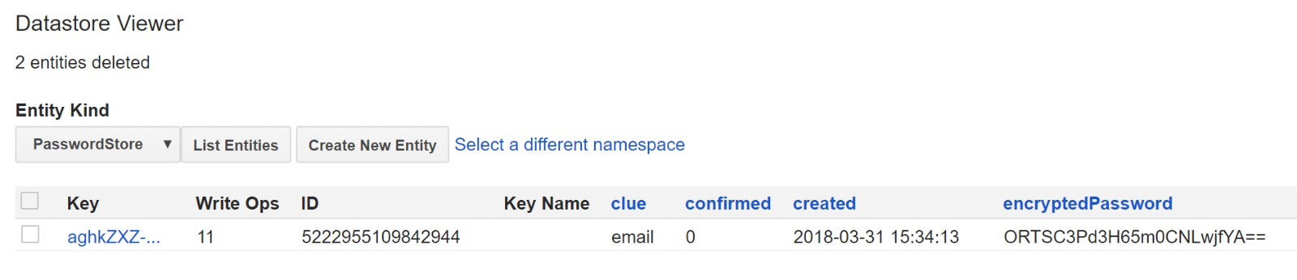
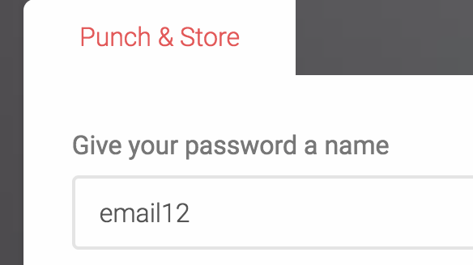
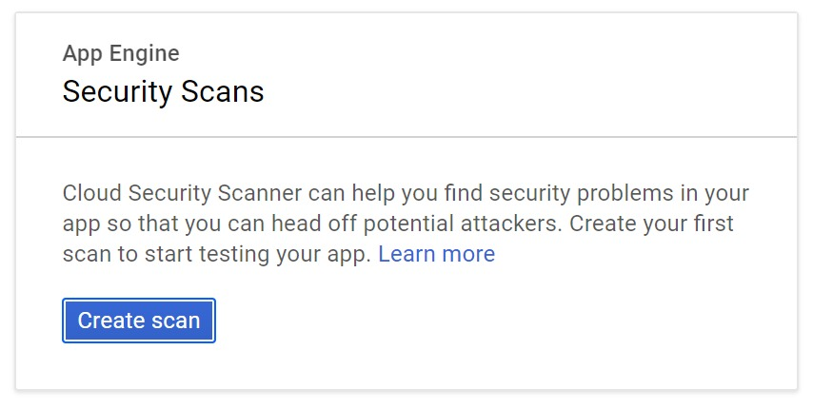
How secure is our application?
Users information is encrypted and cannot be interpreted
Users are more likely to trust and use the sites that use HTTPS
Passwords are stored in an encrypted format on the database
A clue that matches, that needs personal knowledge of the user to retrieve the password
Google’s web security scanner, that checks for common vulnerabilities

Slide 5

Why Google Services?
Platform as a service
Application Security
Scalability
Pricing

